Slide 1
PRECAST PLANT SETUP, FUNCTIONING & LOGISTICAL REQUIREMENTS
By,
Mr. C Satyanarayana
(MD, Inventaa Industries)

Slide 2
ABOUT INVENTAA INDUSTRIES
SINCE 1979
Inventaa Industries was established by Mr. C Satyanarayana, a chemical engineer, in 1979. The company started with manufacturing of Bulk Drugs & Fine Chemicals.
USFDA Approved facility
No. 1 exporter of specific APIs to the US Market (80% market share)
Diversified businesses in the field of Agro Products.
Number 1 producer of Button mushrooms in India.
Completely “Cloud Controlled” production system
Setup Building Product Division in 2016 - Largest installed capacity in India.
All core machinery imported from industry leaders; Elematic (Finland) for precast machinery, Rekers (Germany) for Designer Pavers and Dutch technology for AAC Blocks.

Slide 3
PRECAST CONCRETE DIVISION
Installed capacity of 6 mn sqft/year to construct all types of buildings.
04 Nos. of Precast Plants - Largest Installed Capacity in India
04 nos. Elematic E9 Extruders - Maximum numbers in India
03 nos. Elematic Concrete Shuttles for Automated Concrete Distribution
AAC Plant, fully Automatic - Largest capacity in India - 2,000 m³/day
Designer Pavers Plant - 56,000 sq.ft. per day - black, grey, coloured with normal and sand blasted finish.

Slide 4
MISSION & VISION STATEMENT
OUR MISSION:
Inventaa has a mission of providing high-quality and sustainable precast construction services and building products to our clients through the use of modern technology and automation.
The management is focused on continuous process improvement, highest business standards, work ethics and corporate citizenship.
OUR VISION:
To be the most innovative sustainable and reliable producer, manufacturer, services and solution provider in each of our business verticals.

Slide 5
TYPES OF ELEMENTS & MOULDS
Type of element | Mould needed
Walls - Load Bearing, Non-load Bearing, Internal, Facade. | Casting Tables
Columns & Beams | Fabricated Moulds
HCS - Hollow core slabs | HCS beds
Prestressed Beams | Casting beds with prestressing abutments
Staircase - Flights and Landings | Staircase moulds
Special elements (Ex: Troughs, Purlins, I-beams) | Specialised moulds

Slide 6
TYPES OF PRECAST PLANTS

Slide 7
TYPES OF PRECAST PLANTS
Central precast plant.
Central precast plants will be having a huge capacity to feed multiple project within 300-500 km radius.
Mobile/Site based plant
Based on the project location, requirements and feasibility, we choose the mobile precast plant.
Mobile/Site based precast plant is generally adapted, where adequate space is available at project location.
To overcome the constraints on the transportation of precast elements to reduce cast and time.
At Inventaa Industries we have,
Central precast plants at Keesara, Hyderabad and Bhubaneswar.
Mobile/Site based precast plants at Peddapuram and Bhubaneswar.

Slide 8
CENTRAL PRECAST PLANT #1
Location – Keesara, Andhra Pradesh
Total Plant Area – 60+ acres
PC Plant Area - 28 acres for Precast Plant , 2 Lac. sq.ft. covered building area
Concrete Production Capacity - 3 Batching Plants (Batch Sizes - 1.5m³, 1.0m³, 1.0m³)
Precast Machinery and Moulds
Elematic - Hollow Core Slabs – 5 x 120m
Casting Tables – 40 nos (4m x 8m)
Prestressed Beam/Column Line – 1 x 120m
Staircases – 8 nos.
AAC – Dutch System – Up to 2,000m³/day
Rekers (Germany) - Pavers - 56,000ft²
Other Equipment
Tower & Mobile Cranes
Overhead Cranes
Batching & Mixing Plants
Boom Placers
Trailers
JCB/Loaders

Slide 9
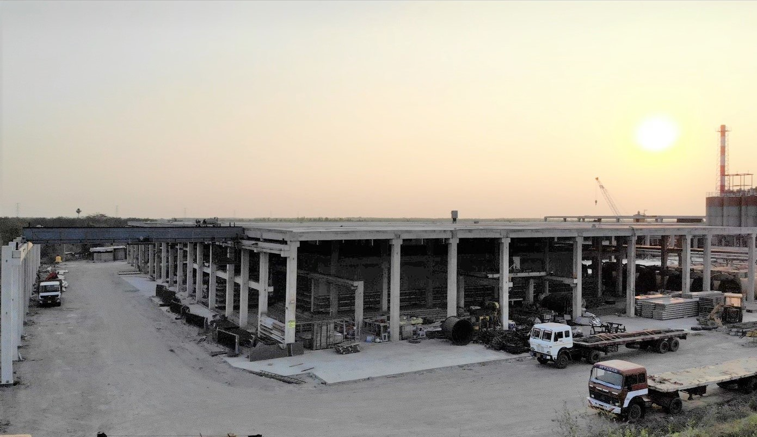
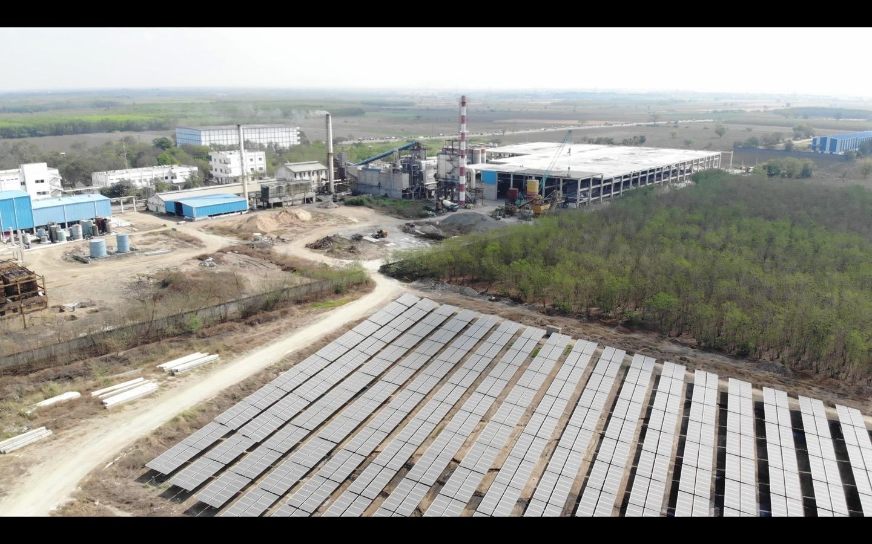
The precast plant is located on the Hyderabad-Vijayawada Highway, having excellent connectivity to most districts in Telangana State and Andhra Pradesh. Distance between our factory and Vizag is approx. 400 km.
In order to be self-sustained, we have our own solar power generation of 2 MW for captive consumption.

Slide 10
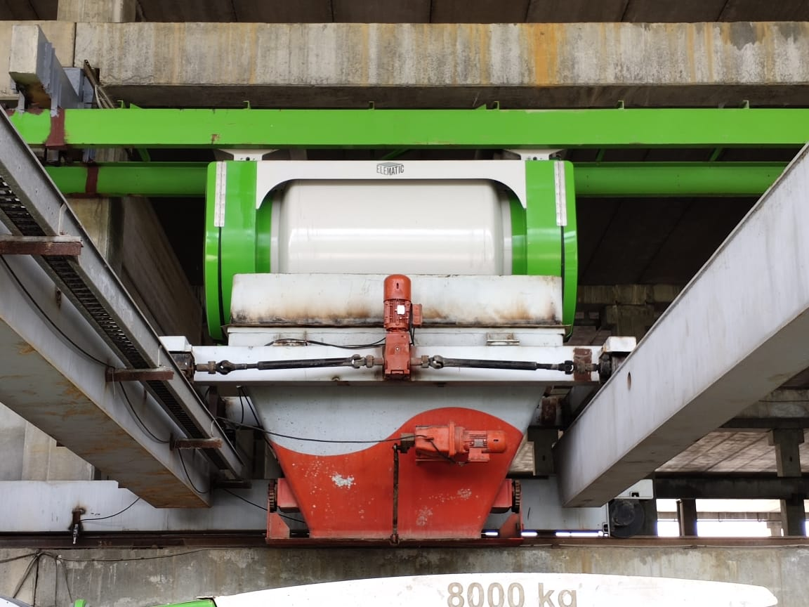
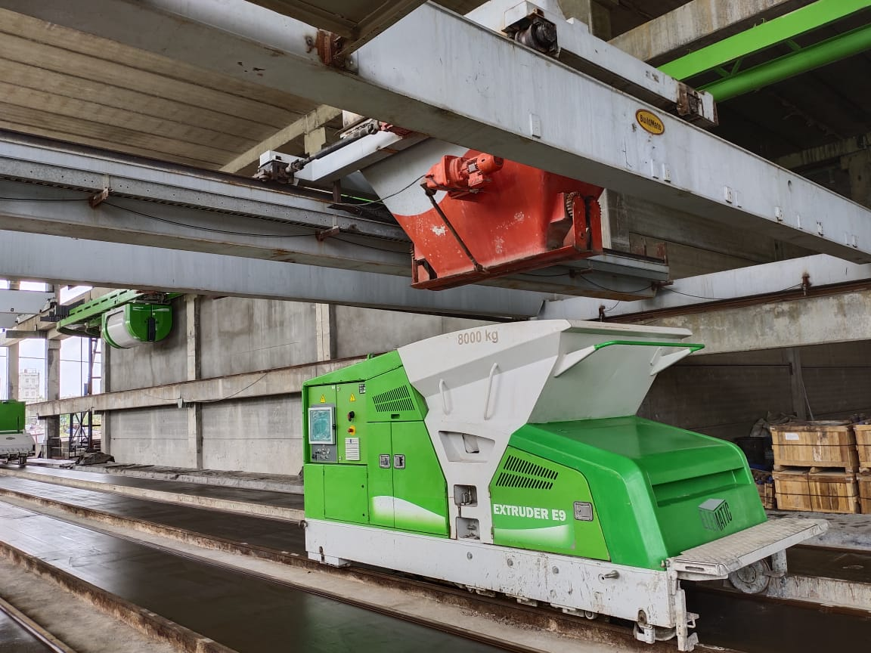
AUTOMATED CONCRETE DISTRIBUTION SYSTEM
Shuttle discharges concrete into the distributor machine (Left)
Distributor moves in X-Y direction to provide concrete to the Extruder Machine anywhere along the 120m bed (Up)

Slide 11
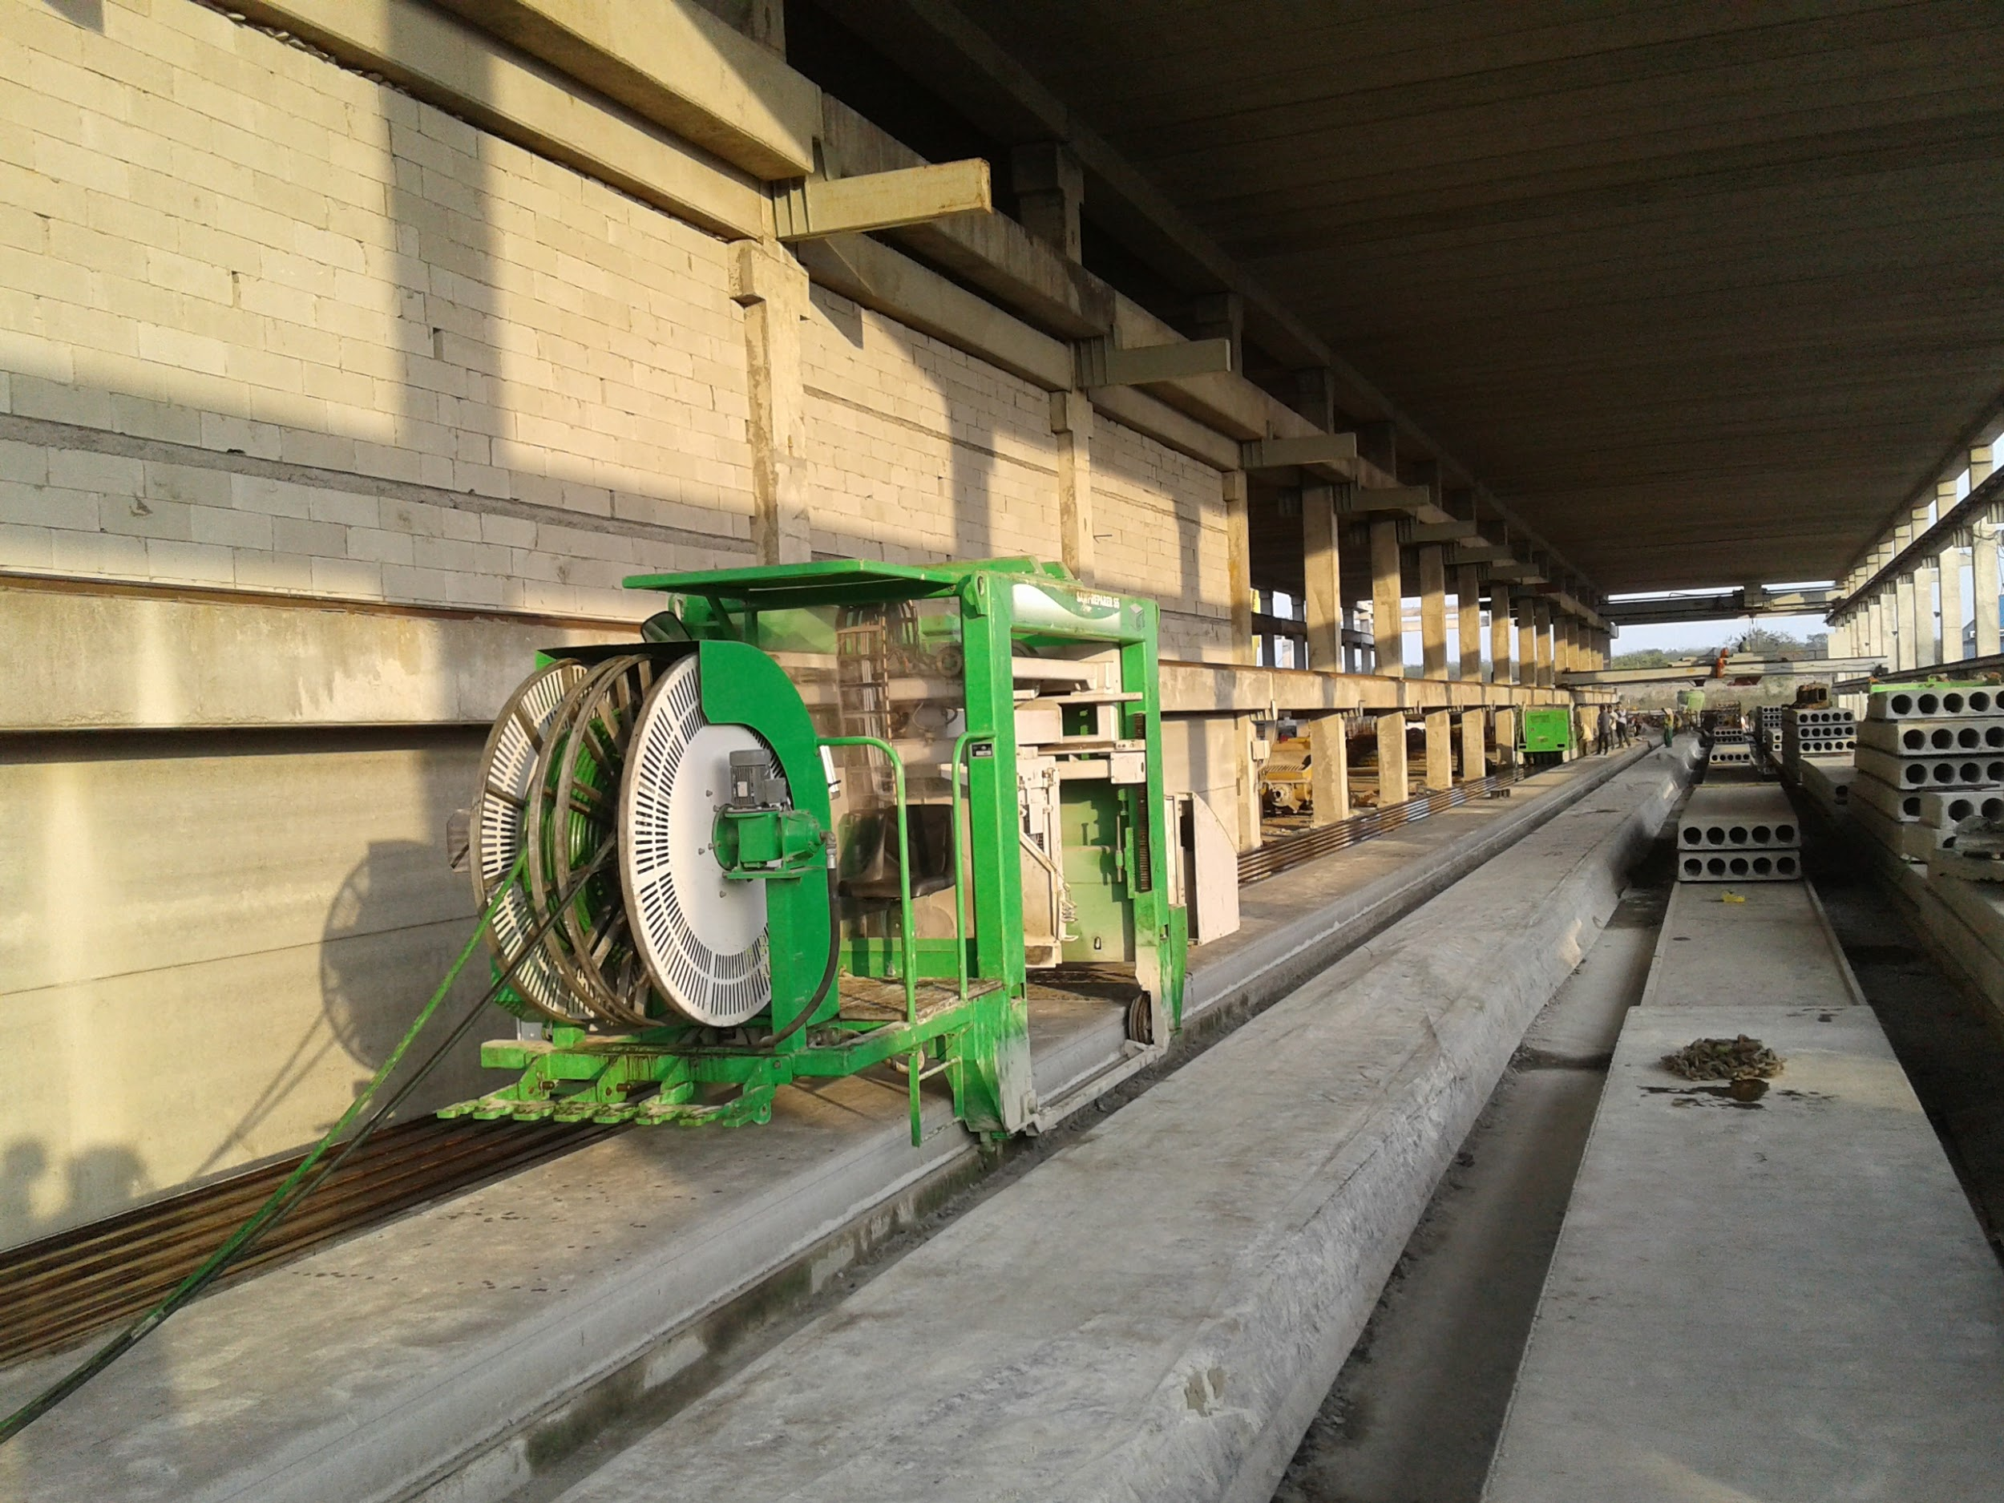
Production capacity of 7,750 sq.ft. Hollow Core Prestressed Slabs.
Thicknesses of slabs from 120mm up to 400mm.

Slide 12
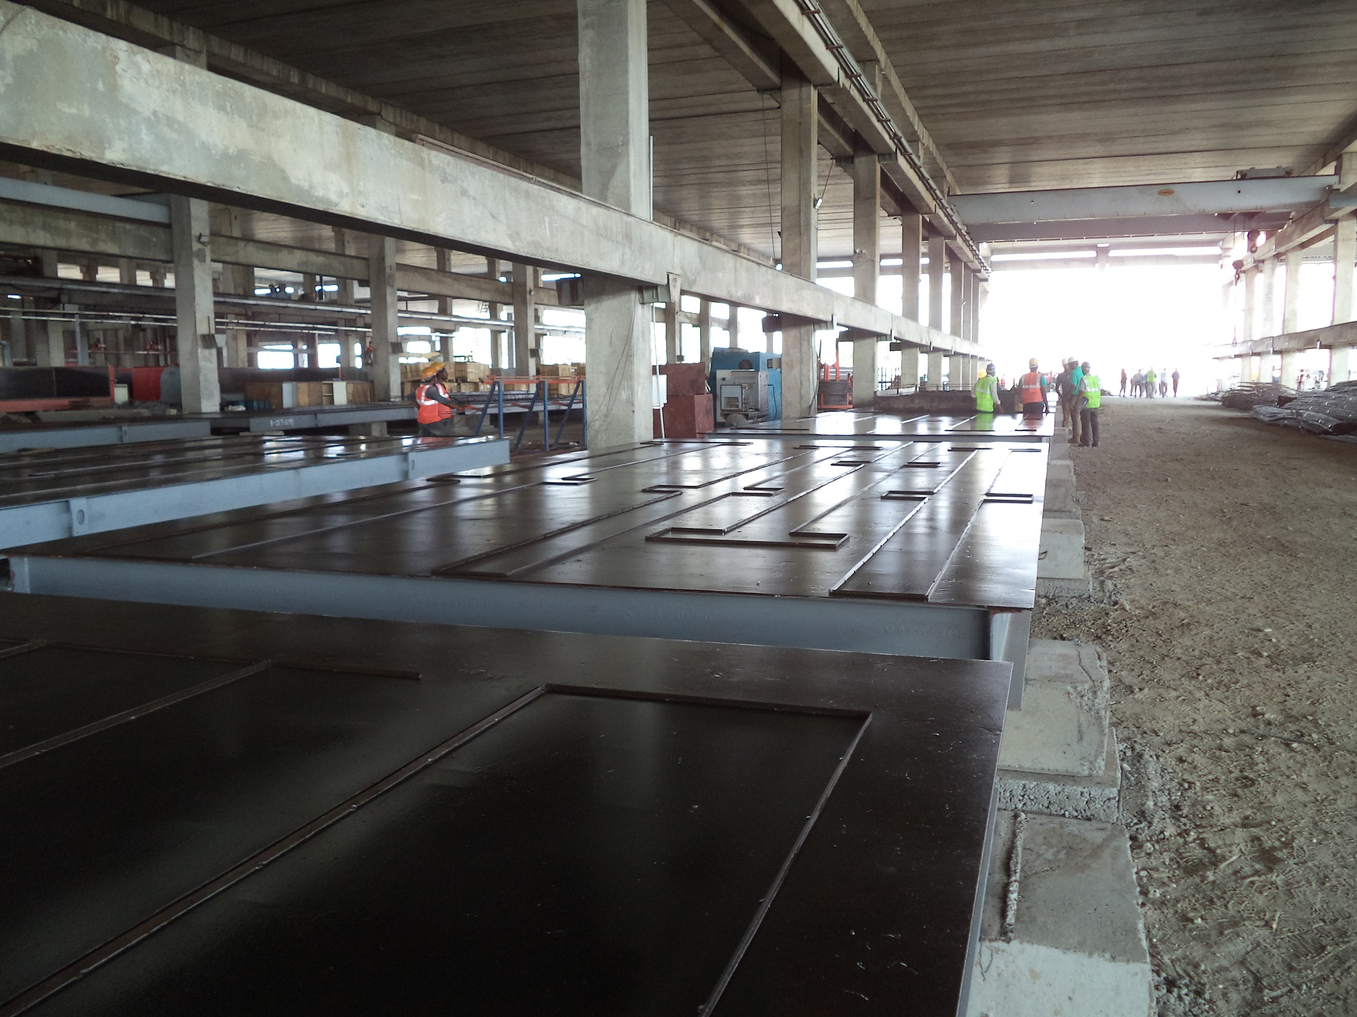
40 nos. Tables of 4m x 8m for production of load bearing walls, facade walls, filigree slabs and small columns and beams.

Slide 13
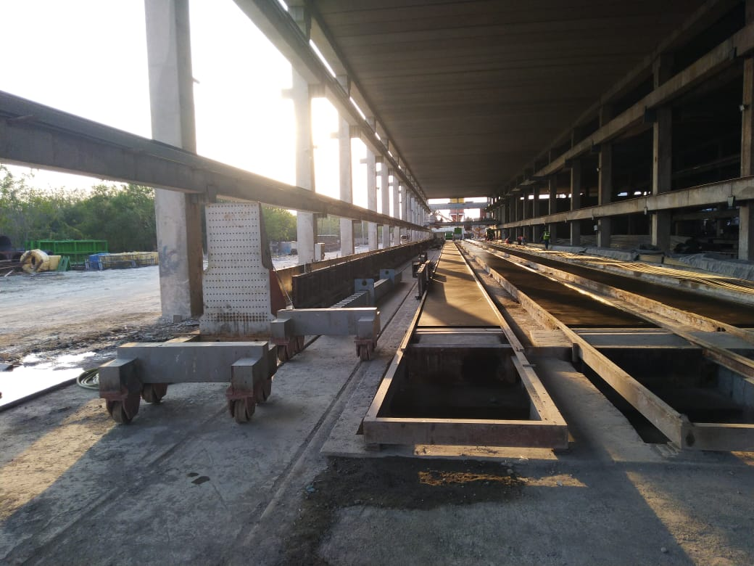
Abutment for producing up to 1.2m x 1.2m wide prestressed beams.
Production of reinforced columns and reinforced/prestressed beams. These are done either on steel tables (4m x 8m) or on special casting beds which are 120m long.

Slide 14
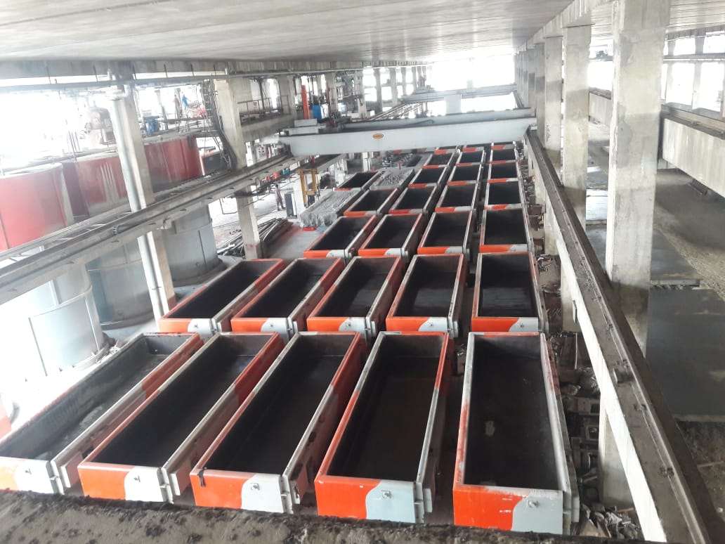
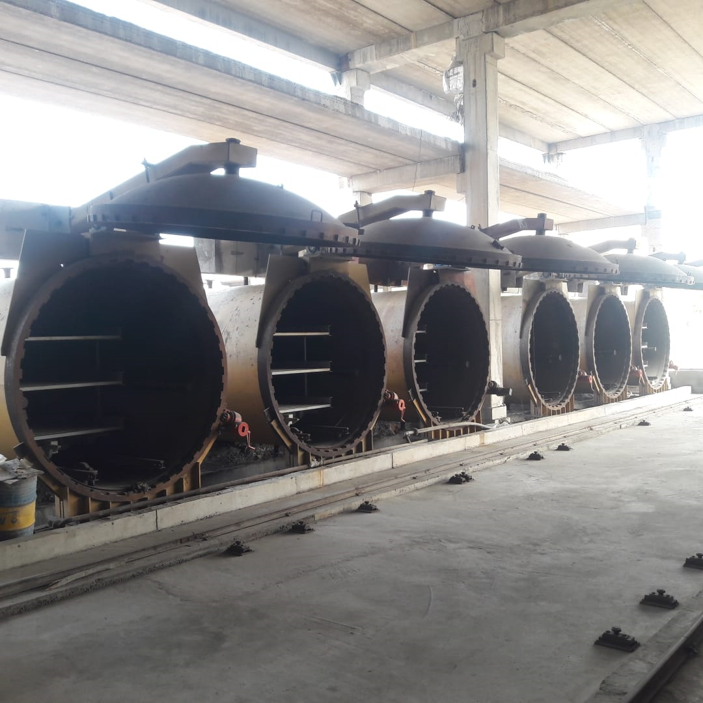
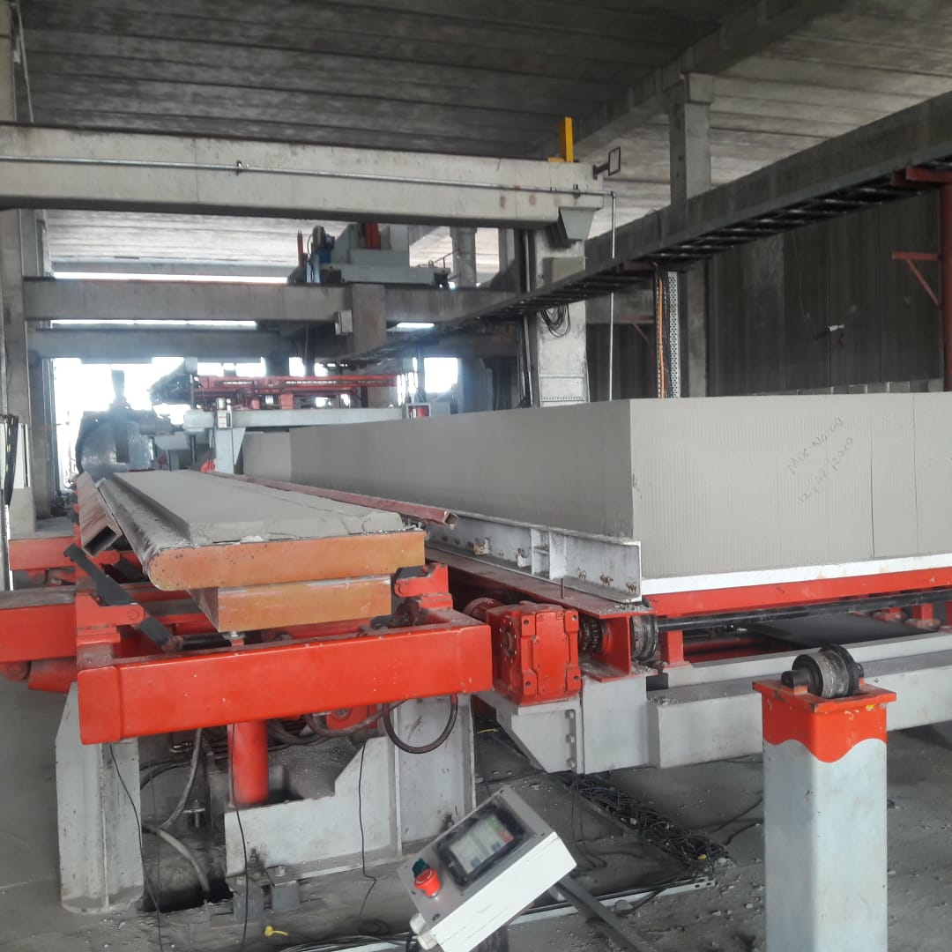
Fully Automatic Aerated Autoclaved Concrete Plant with one of India’s largest capacity of producing up to 2,000m3 of AAC Blocks per day.

Slide 15
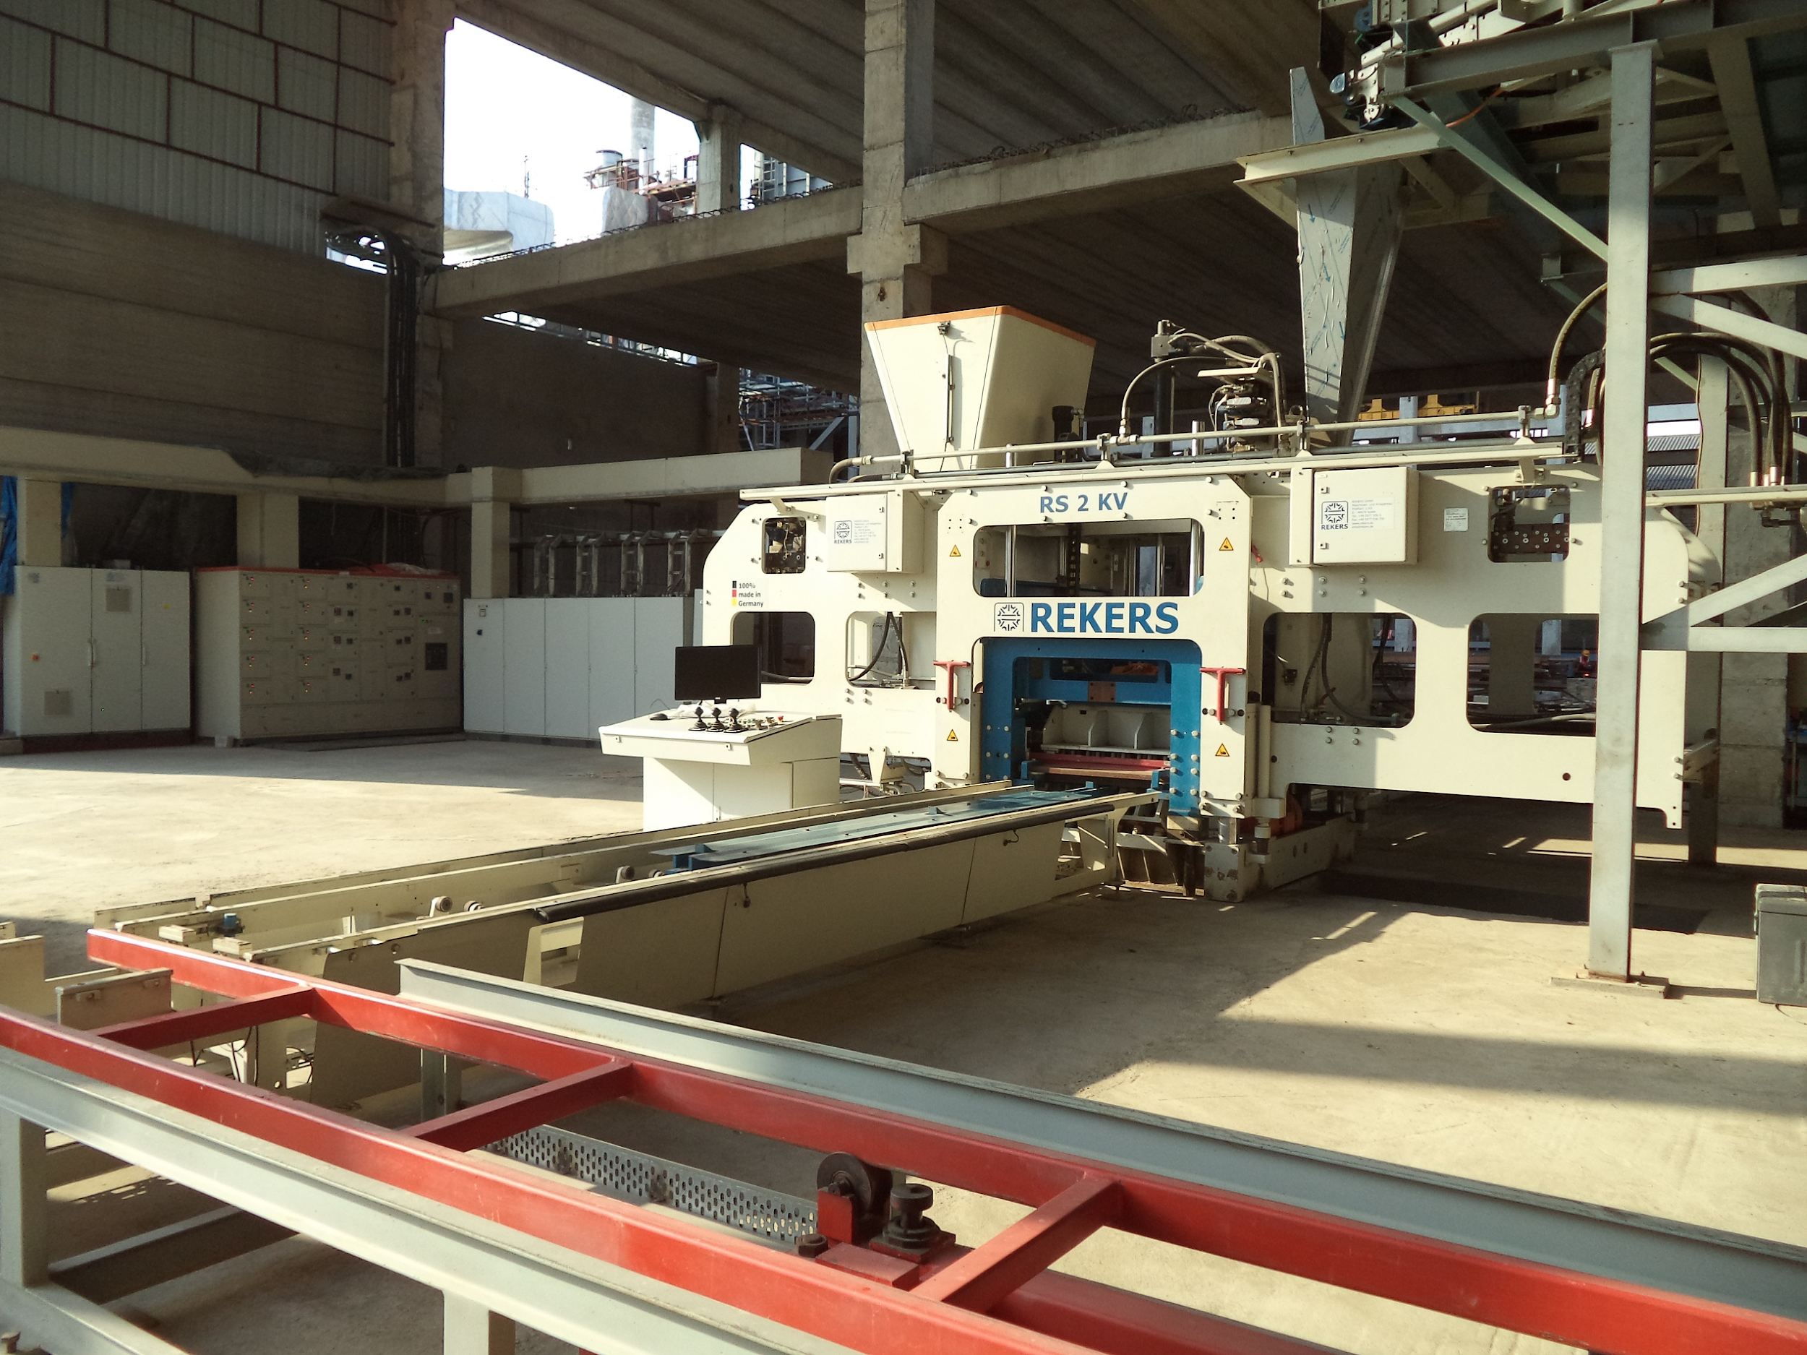
Fully Automatic Concrete Paver Block Plant from Rekers (Germany) with capacity of producing black, grey and coloured paver blocks with plain and sand blasted finish in various shapes.

Slide 16
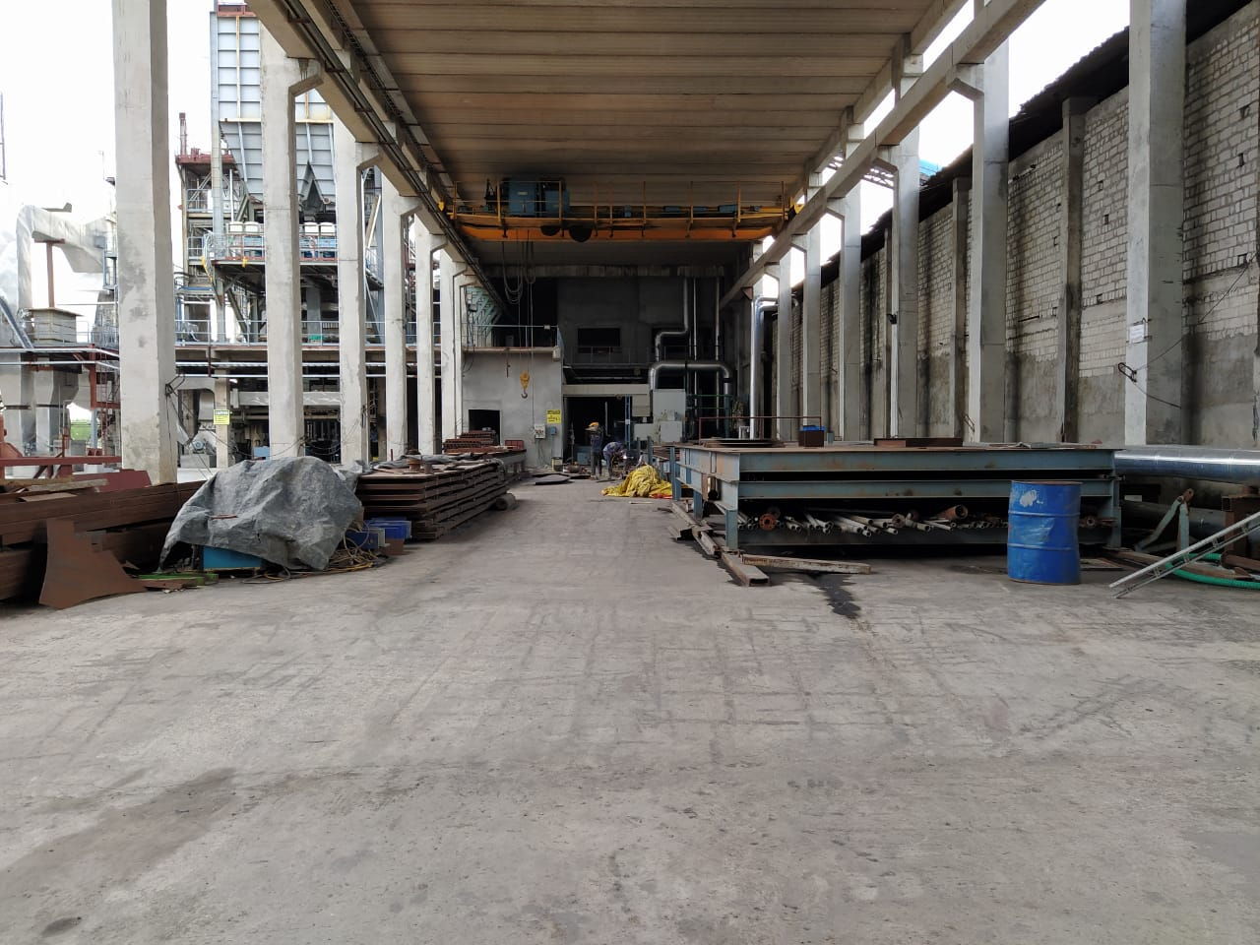
In-house fabrication shop for preparation of moulds, shuttering and side forms. Experience in fabrication of precast casting moulds, silos and special steel fabrication items for captive use.

Slide 17
CENTRAL PRECAST PLANT #2
Location – Hyderabad, Telangana State
Total Plant Area – 10.50 acres
PC Plant Area - 7 acres
Concrete Production Capacity - 2 Batching Plants (Batch Sizes - 1.25m³, 0.5m³)
Precast Machinery and Moulds
Elematic - Hollow Core Slabs – 5 x 120m
Elematic KVT Line - 9 tables
Circulation Line - 45 tables
Staircases – 2 x double molds (4 flights)
Other Equipment
Tower & Mobile Cranes
Overhead Cranes
Batching & Mixing Plants
Boom Placer
Loader

Slide 18
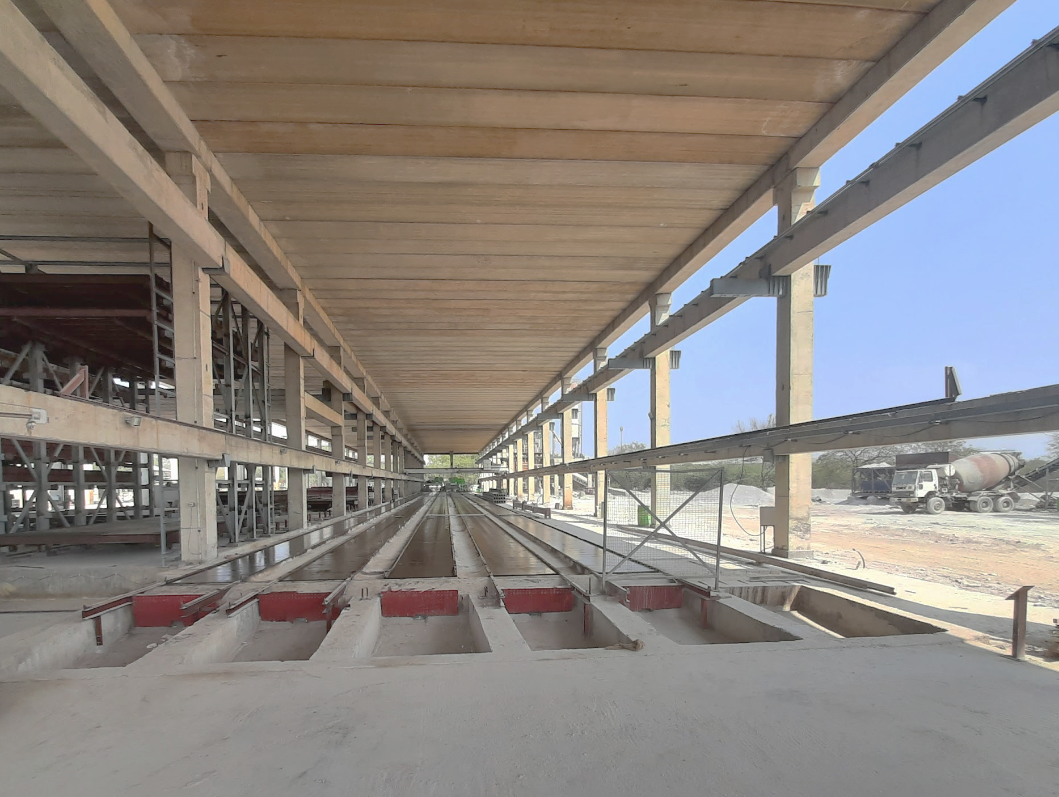
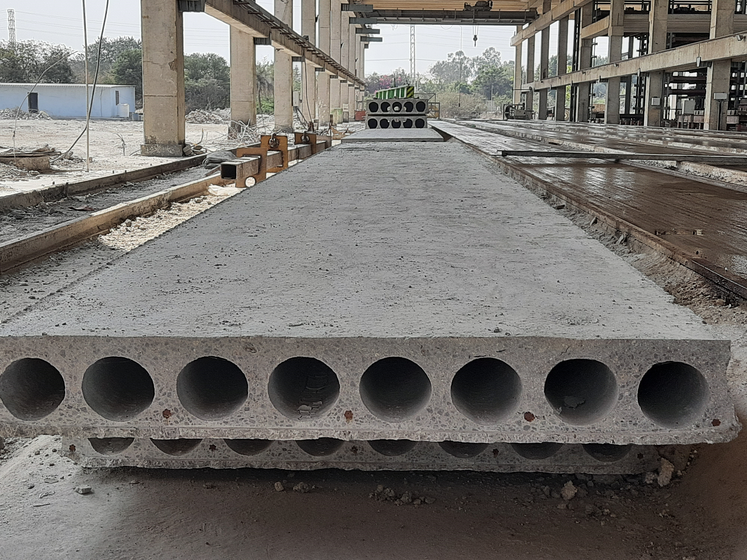
Production capacity of 7,750 sq.ft. Hollow Core Prestressed Slabs.
Thicknesses from 120mm up to 400mm.

Slide 19
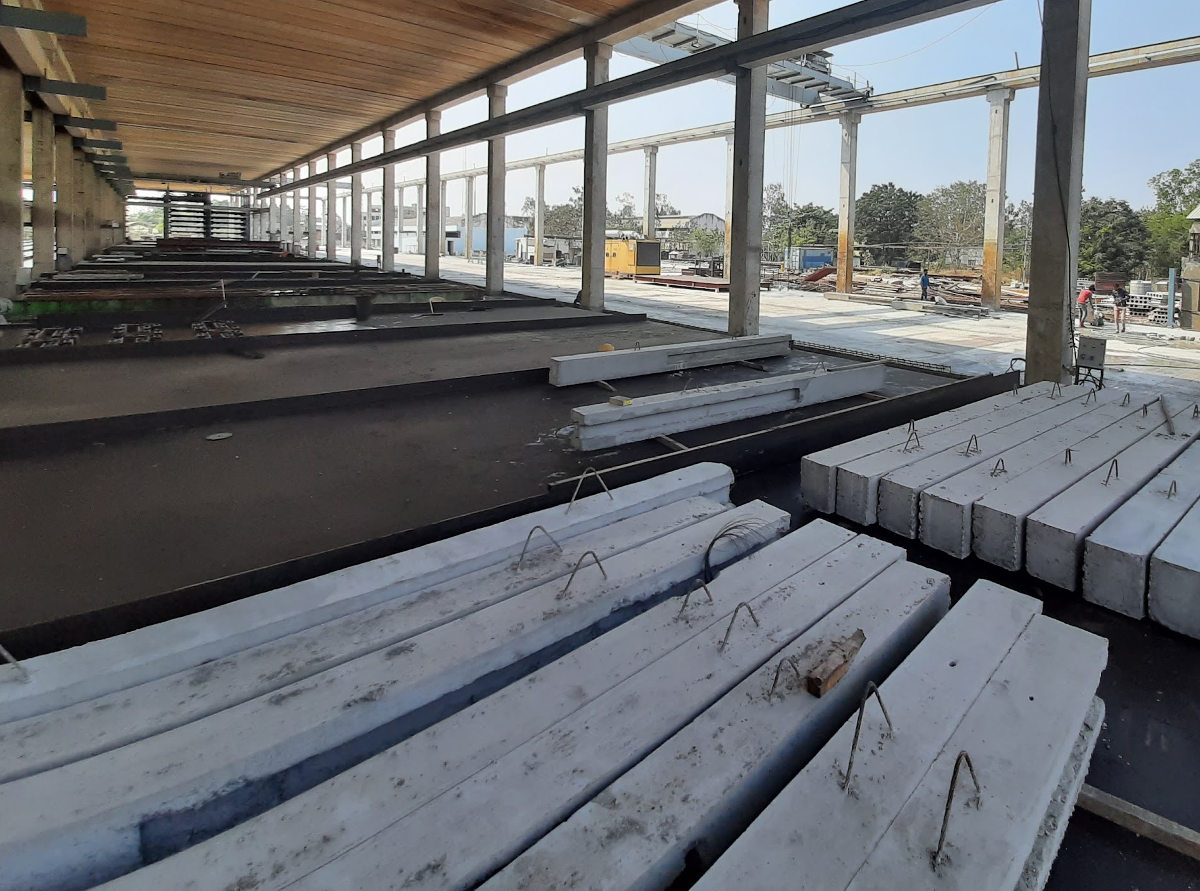
Fully automatic 45 table circulation line along with KVT (Multi-Function Wagon) Line for production of Walls and Reinforced Slabs

Slide 20
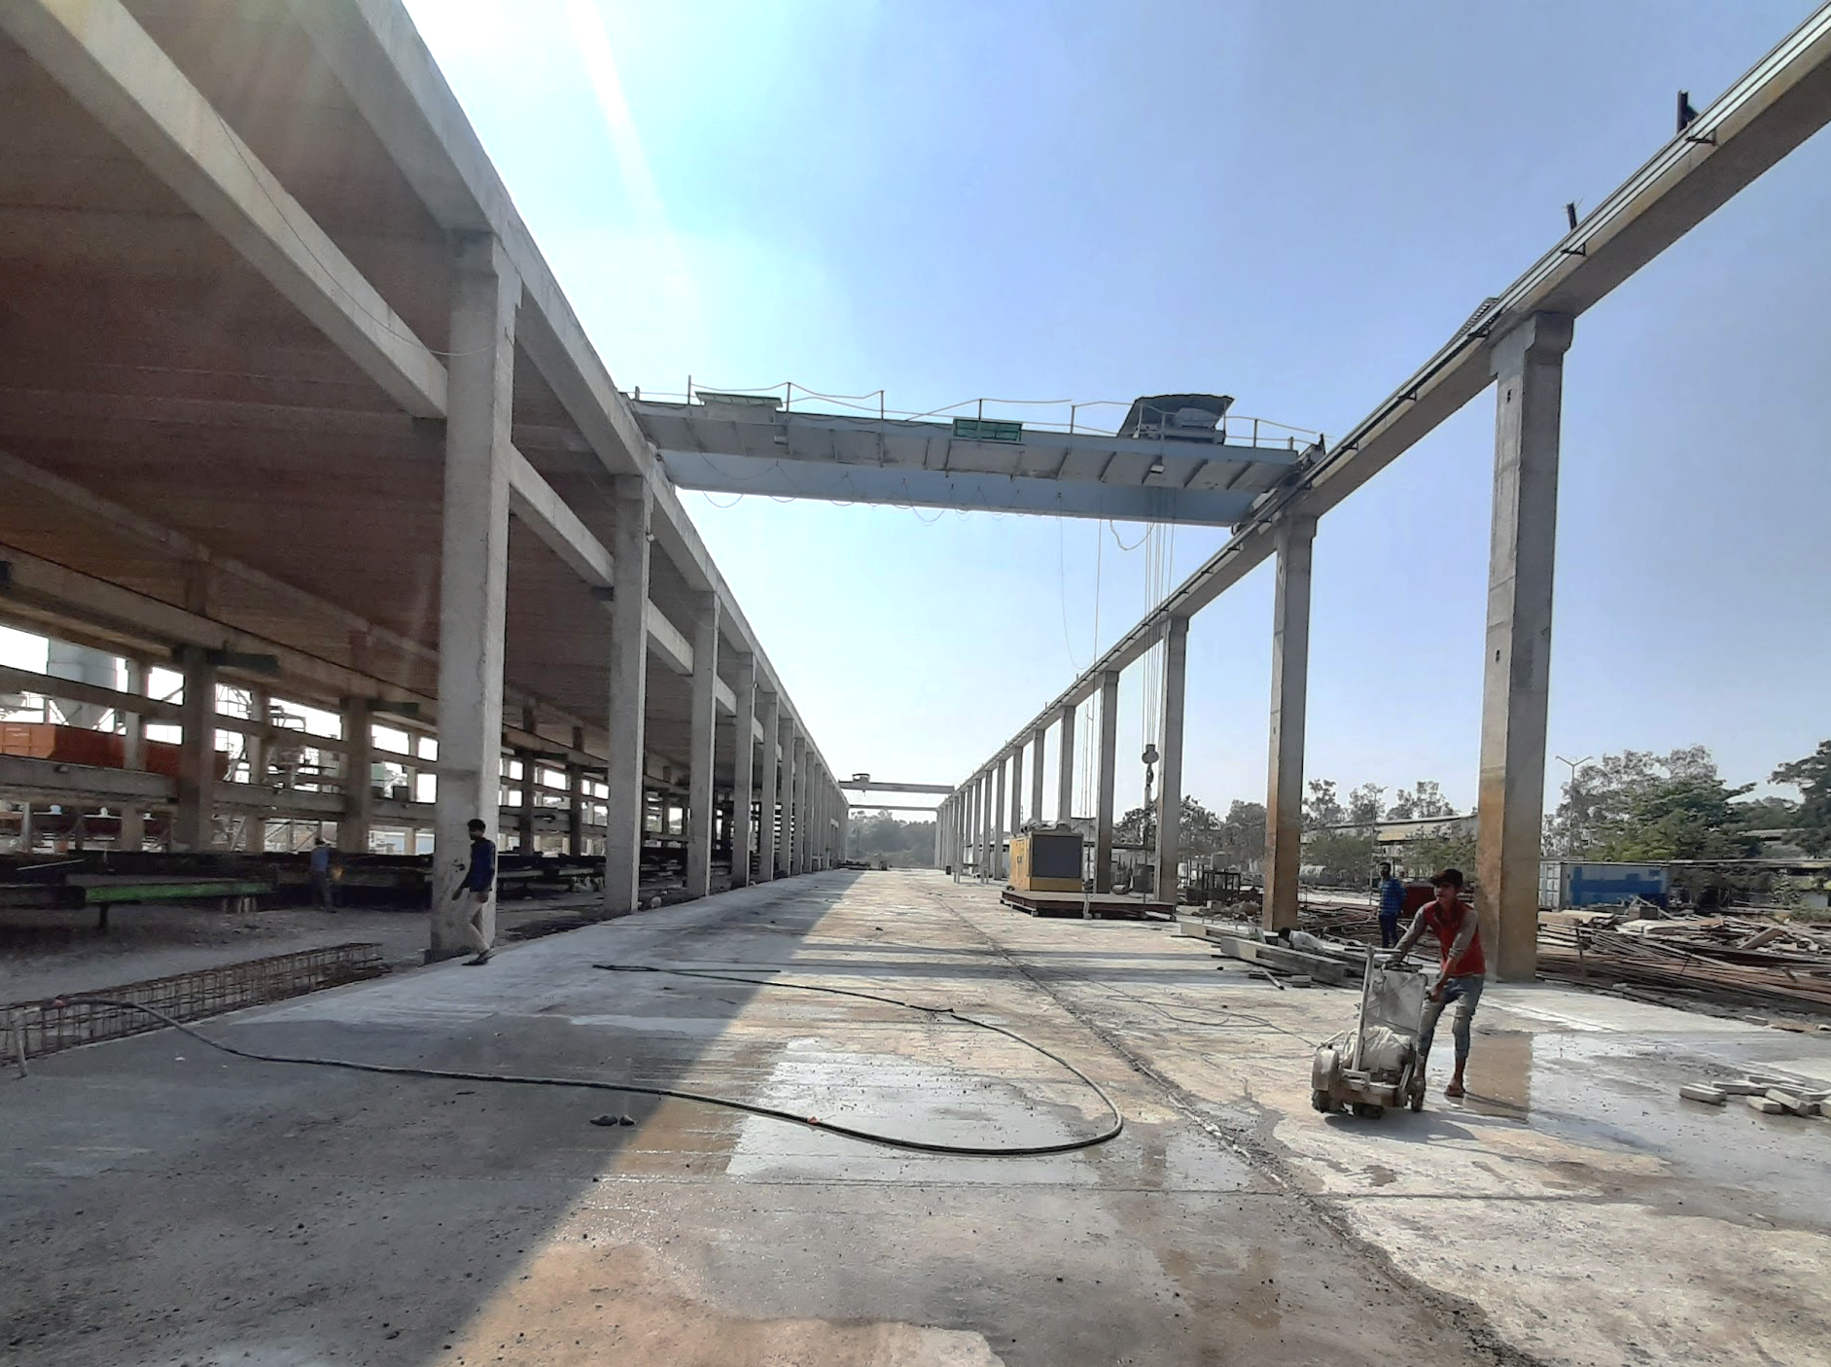
15m x 160m long, dedicated stockyard and loading bay for precast elements.

Slide 21
MOBILE/SITE BASED PRECAST PLANT
Location – Peddapuram, Andhra Pradesh
Plant Area – 4 acres for PC Plant
Precast Elements -
- Columns
- Reinforced Beams
- Load Bearing Walls
- Staircases
Machinery & Moulds -
- Casting Tables – 15 nos.
- Staircase Mould – 2 nos.
Project -
- Construction of Mall at Rajahmundry
Location – Bhubaneswar, Odisha
Plant Area – 12 acres
Precast Elements -
- Columns
- Reinforced Beams
- Load Bearing Walls
- ACOTEC Precast Partition Walls (Permanent Setup)
- Staircases
Machinery & Moulds -
- Elematic - Acotec Line – Partition Walls
- Casting Tables - 33 tables - 4m x 8m
- Staircases – 4 nos.
Project -
- Construction of 5.50 lac sq.ft. of low-rise affordable housing project. Total 1320 no. of housing units.

Slide 22
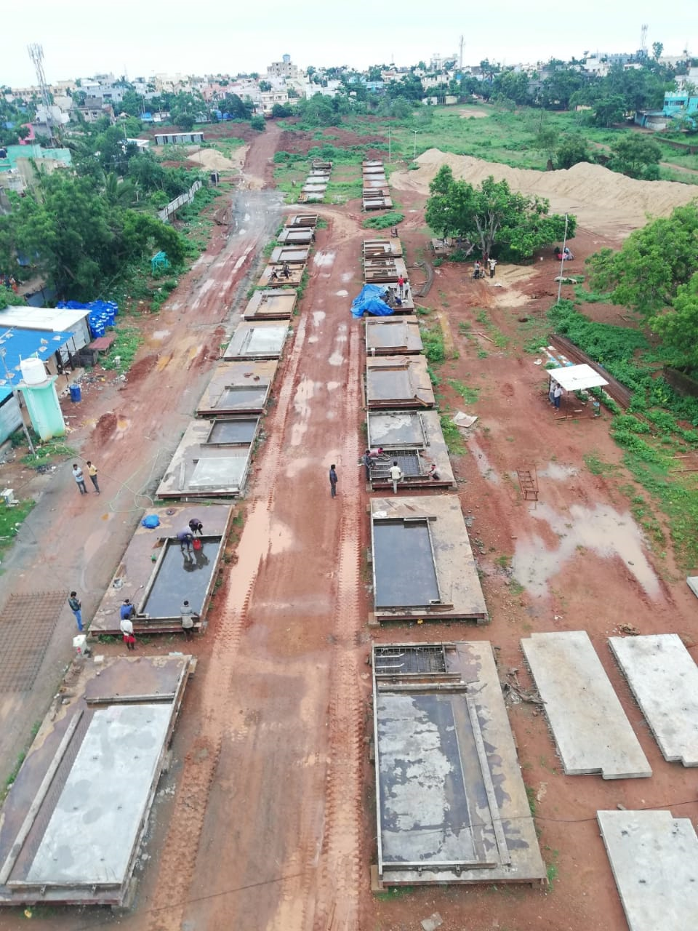
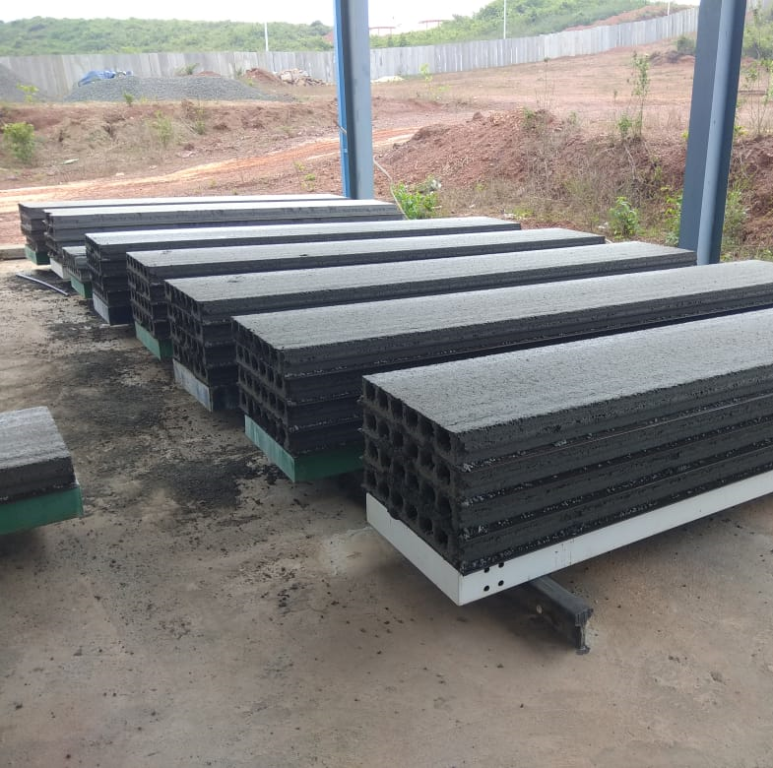
Precast Plant #4, Site Based Plant, Bhubaneswar, Odisha.
In addition to the site based plant we also have a permanent factory based plant for the production of Precast Partition Wall Panels (Acotec Walls)

Slide 23
PRECAST PLANT LOGISTICS
One of the key aspects to determine while setting up a precast plant the logistic plan. This consists of deliberation on the following points -
Space requirements of factory shed, B&M Plant, Aggregate storage, lab, stores etc..
Material movement (raw material & finished goods)
Logistics inside production hall (safety and ease of manpower and material movement)
Handling of produced elements and shifting to the stockyard
Future expansion plans & contingencies

Slide 24
Thank you!

